Slide 1
Models in Biology Or: Biology is more theoretical than physics
Yoav Ram
School of Zoology
Tel Aviv University
Spring 2023

Slide 2
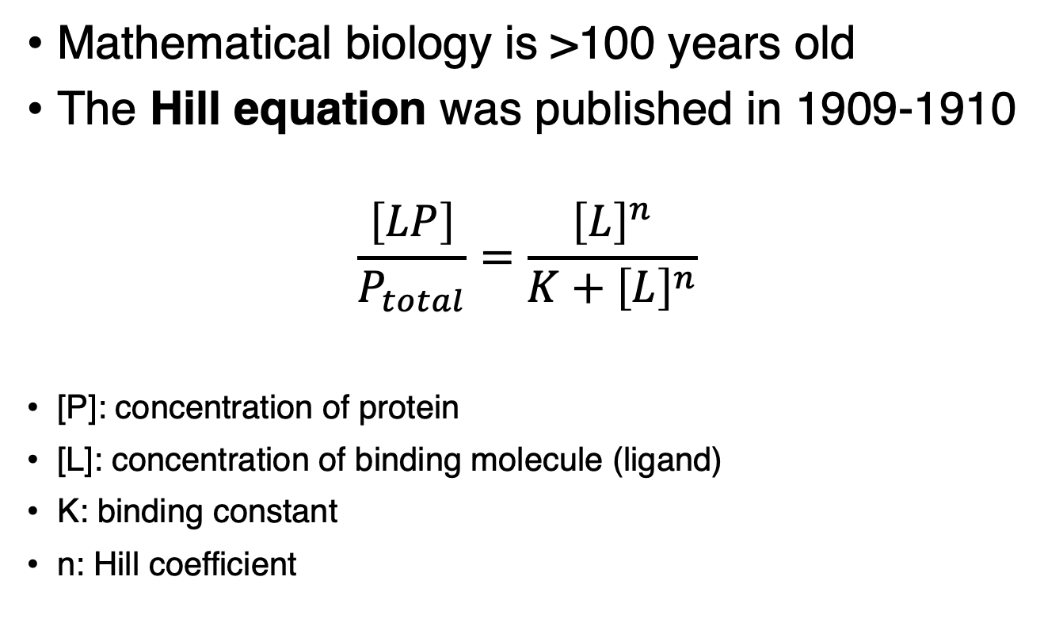
History
Mathematical biology is >100 years old
The Hill equation was published in 1909-1910
$$\frac{\left[LP\right]}{P_{total}}=\frac{{\left[L\right]}^{n}}{K+{\left[L\right]}^{n}}$$
[P]: concentration of protein
[L]: concentration of binding molecule (ligand)
K: binding constant
n: Hill coefficient

Slide 3
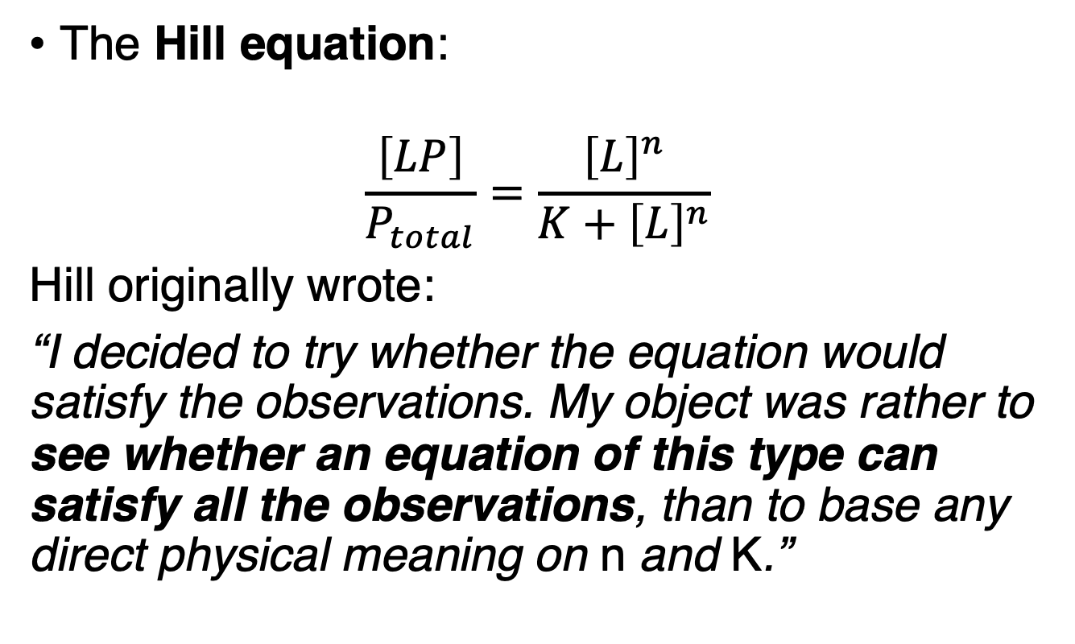
History
The Hill equation:
$$\frac{\left[LP\right]}{P_{total}}=\frac{{\left[L\right]}^{n}}{K+{\left[L\right]}^{n}}$$
Hill originally wrote:
“I decided to try whether the equation would satisfy the observations. My object was rather to see whether an equation of this type can satisfy all the observations, than to base any direct physical meaning on n and K.”
AV Hill (UK)
1886 –1977
Hill AV, J Physiol 1910

Slide 4
Mendel’s experiments
Mendel studied pea traits (1860s):
Flower color: purple/white
Flower position: axil/terminal
Stem length: long/short
Seed shape: round/wrinkled
Seed color: yellow/green
Pod shape: inflated/constricted
Pod color: green/yellow

Slide 5
Mendel’s experiments

Slide 6
Mendel’s experiments

Slide 7
Mendel’s experiments

Slide 8
Mendel’s experiments

Slide 9
Mendel’s Laws
Segregation: GG+YY->GY
Independent assortment: G/Y free of T/S
Dominance: Y>G

Slide 10
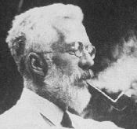
The Gene
Gregor Mendel
(Czech/Austria)
1822 – 1884
Mendelian genetics Quantitative analysis of experiments, Mendel 1865-66
Genes unknown!
Classical genetics merged Mendel with chromosome microscopy, Morgan 1915
Population genetics Genetics merged with natural selection
Fisher, Wright, Haldane 1920s
☞ The Modern Synthesis of Evolution (1930s)
Still: Genes unknown!!!
TH Morgan (USA)
1866 –1945
RA Fisher (UK)
1890 –1962

Slide 11
The Gene
Luria–Delbrück experiment (1943): mutations arise separately from selection
Hershey–Chase experiments (1952): DNA responsible for inheritance
DNA Structure (1953): Watson, Crick, Franklin, Wilkins
Genetic Code (50s-60s)
☞Molecular genetics:
The Gene is Here
Martha Chase (USA)
1927 – 2003
Salvador Luria
(Italy/USA) 1912 –1991
Rosalind Franklin (UK)
1920 – 1958

Slide 12
Strategies of model building

Slide 13
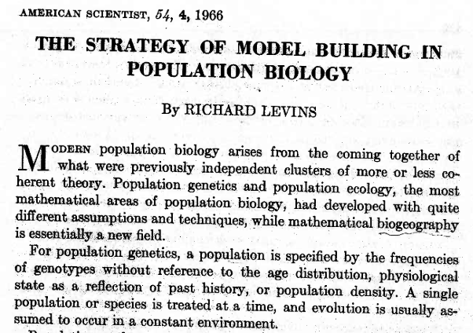
Strategies of model building
Richard Levins
(USA) 1930 –2016

Slide 14
Nature is complex
Everything is connected:
A Tangled Bank
"It is interesting to contemplate a tangled bank, clothed with many plants of many kinds, with birds singing on the bushes, with various insects flitting about, and with worms crawling through the damp earth, and to reflect that these elaborately constructed forms, so different from each other, and dependent upon each other in so complex a manner…”
-- Charles Darwin "On the Origin of Species"

Slide 15
Naïve brute-force approach
Full mathematical model
One-to-one reflection of natural system
In short: model everything
>100s of equations
>100s of parameters
Numerical solutions
Compare solutions to nature

Slide 16
Naïve brute-force approach
Too many parameters too measure
Equations cannot be solved, or
Solutions cannot be interpreted

Slide 17
Naïve brute-force approach
Too many parameters too measure
Equations cannot be solved, or
Solutions cannot be interpreted
Need to simplify and approximate
while preserving the essential features of the system

Slide 18
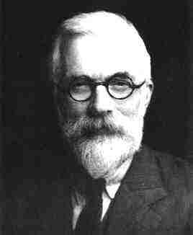
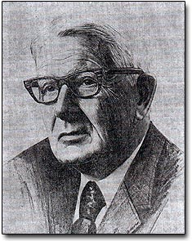
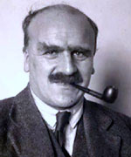
Example: Population genetics
Research question (1920s):
Can weak natural selection account for evolutionary change?
Simplifications:
Follow frequencies of genotypes
Disregard density, age, physiological state
Constant environment
RA Fisher (UK)
1890 –1962
Sewall Wright
(USA) 1889-1988
JBS Haldane
(UK/India) 1892-1964

Slide 19
The model builder’s trilemma

Slide 20
The model builder’s trilemma
According to Levins:
The model builder must pick two of three:
Generality
Precision
Realism

Slide 21
The model builder’s trilemma
Sacrifice generality to realism and precision:
Focus on parameters relevant to narrow problem
Make lots of accurate measurements (nice big data!!)
Solve numerically (lots of computing, no interpretation)
Provide precise testable predictions to specific scenario
Examples:
Computer vision
Modelling fish populations in Canada

Slide 22
The model builder’s trilemma
Sacrifice realism to generality and precision:
in hopes that
unrealistic assumptions cancel each other
small deviations from realism → small deviations in results
departures from model results will suggest further research
Examples:
Predator-prey models (Lotka-Volterra)
Frictionless systems
Perfect gases

Slide 23
The model builder’s trilemma
Sacrifice precision to generality and realism:
(Approach favored by Levins)
Concerned with qualitative rather then quantitative results
Very general assumptions (x>y, f(x) increasing in x)
Prediction are also general and imprecise (f(x) > f(y))
However, doubt if results depend on essentials or details.
Build models with different simplifications:
“truth is the intersection of lies”
Example: Geographical maps
relative distances correspond to relative distances in reality
color is arbitrary
microscopic view will show the fibers of the paper…

Slide 24
The fibers of the paper

Slide 25
Loosen the trilemma
Depends on
What is the research question?
What kind of data?
Previous work
Sufficient parameters

Slide 26
Sufficient parameters: reduction
Population genetics concept of fitness
Reduces all effects that contribute to change in genotype frequencies
(as popgen focuses on genotype frequencies)
time

Slide 27
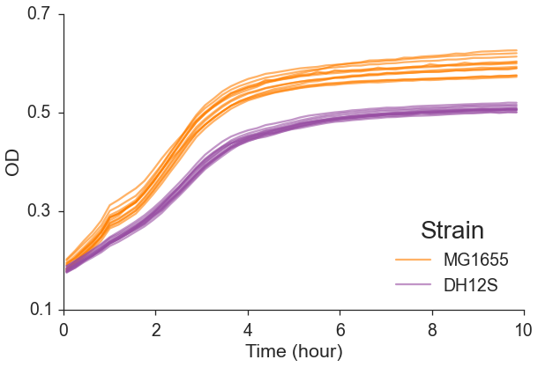
Sufficient parameters: reduction
Can’t go back!
What are the effects that contributed to change in frequency?
Density

Slide 28
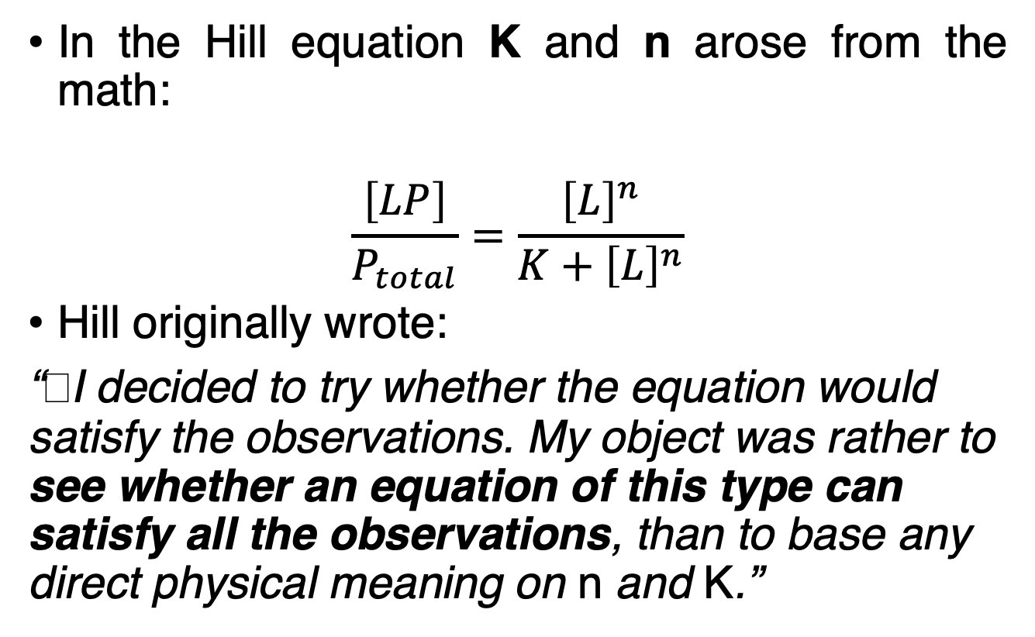
Sufficient parameters: spontaneous
In the Hill equation K and n arose from the math:
$$\frac{\left[LP\right]}{P_{total}}=\frac{{\left[L\right]}^{n}}{K+{\left[L\right]}^{n}}$$
Hill originally wrote:
“﻿I decided to try whether the equation would satisfy the observations. My object was rather to see whether an equation of this type can satisfy all the observations, than to base any direct physical meaning on n and K.”
Hill AV, J Physiol 1910

Slide 29
Sufficient parameters: heuristic
Diversity in ecology: number of species
How many different trees in Carmel vs. Jerusalem?
If Carmel has 50:50 Oren and Alon, and Jerusalem has 80:20, which is more diverse?
Jost L, Oikos 2006

Slide 30
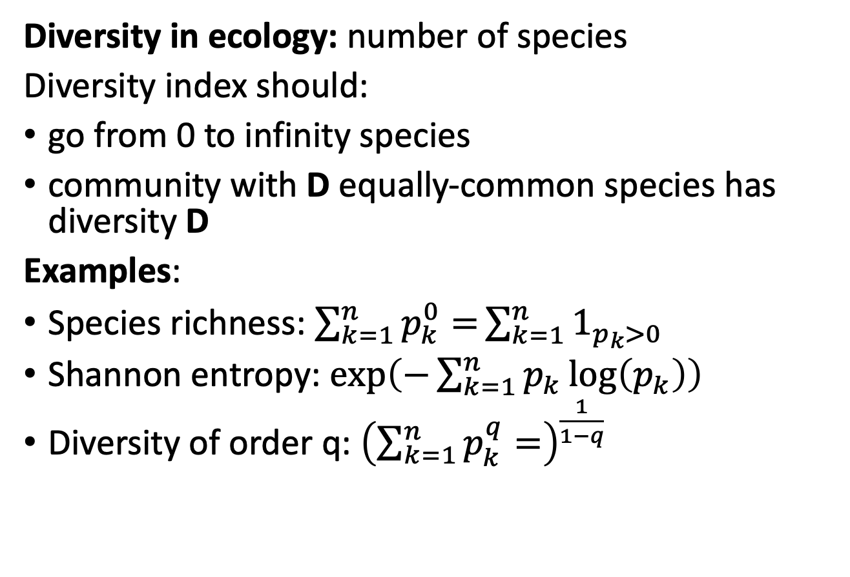
Sufficient parameters: heuristic
Diversity in ecology: number of species
Diversity index should:
go from 0 to infinity species
﻿community with D equally-common species has diversity D
Examples:
Species richness: $\sum_{k=1}^{n}{p_{k}^{0}=}\sum_{k=1}^{n}{1_{p_{k}>0}}$
Shannon entropy: $\exp\left(−\sum_{k=1}^{n}{p_{k}\log\left(p_{k}\right)}\right)$
Diversity of order q: ${\left(\sum_{k=1}^{n}{p_{k}^{q}=}\right)}^{\frac{1}{1−q}}$
Jost L, Oikos 2006

Slide 31
Kinds of imprecision
Due to
Omission of small/rare factors (disregard environmental change)
Vague functional forms (f(x) increasing in x)
Sufficient parameters hide information (exactly how many species? why is red fitter than green?)

Slide 32
Model vs hypothesis vs theory
Hypotheses are
Verifiable by experiment
Models are
True: describe something that can happen
False: leave out a lot
Validated if generated relevant testable hypotheses

Slide 33
Model vs hypothesis vs theory
Models are
Restricted to few components
Theories are
Clusters of related models…
that jointly produce robust theorems…
complement to cope with different aspects…
nested to interpret sufficient parameters of next level

Slide 34
But why can’t we have it all?
Contradiction between
complex heterogenous nature vs.
mind constrained to few simple factors
need to understand vs. control
aesthetics of simple general theorems vs.
richness and diversity of nature

Slide 35

Further reading
Course website – http://modelspopbiol.yoavram.com
Levins R (1966) The strategy of model building in population biology. Am Sci 54(3):421–431.
Plutynski A (2007) Strategies of Model Building in Population Genetics. Philos Sci 73(5):755–764.
Gunawardena J (2013) Biology is more theoretical than physics. Mol Biol Cell 24(12):1827–1829.

